Slide 1
Finding the neighbourhood Restaurents in Cologne

Slide 2
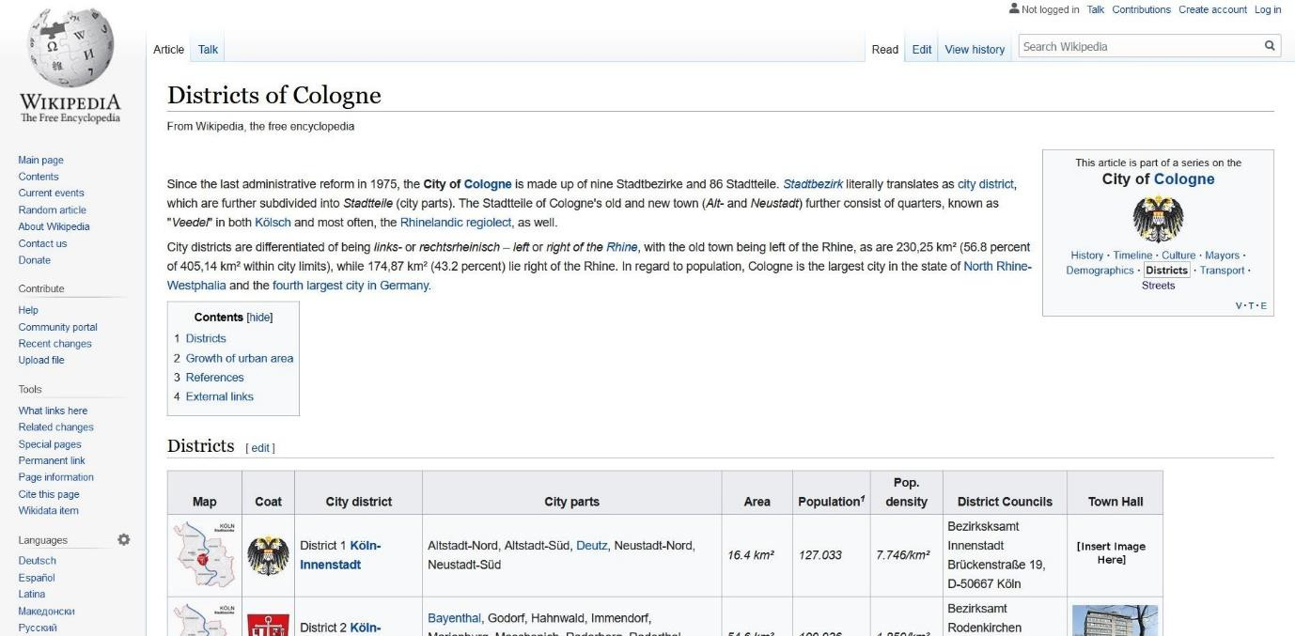
The Restaurant Battle of Neighborhoods in Cologne
Cologne, the city the author lives in, attracts a large number of tourists, not least due to its famous cathedral, the trade fairs and conventions, its vibrant party scene. For tourists, finding the right place to eat can be a challenge, though. German dishes include a lot of meat, often pork, which many people do not want to eat for health-related, religious, cultural, or moral reasons. This is just one motive for giving tourists a good overview about what to eat where.
Thus, the goal I want to reach with this exercise is to give a simple recommendation to tourists in Cologne: in which district of the city will you find a large number or even concentration of which types of restaurants? Where to eat Mediterranean food, where to find German food, where to get fast food? The target audience are foreign tourists.
Data Preparation
I will, as requested by the assignment task, use foursquare data about restaurants in Cologne. Foursquare is a US tech company from New York focusing on location data. Their technology and data powers apps such as Apple's Maps, Uber, Twitter, and many other household names. I will use foursquare data such as the restaurant name, ID, location, and category of food (vegetarian, Italian etc.).
Also, I will use the overview of districts/city parts of Cologne from Wikipedia
Here, you will find a table "Districts" which shows the nine city districts and its neighborhoods/city parts. I will use these districts and the data about restaurants in these districts from foursquare to show the density of restaurants in them.
Data acquisition and cleaning
Starting out, I scraped data from Wikipedia to create a dataframe with the city districts of Cologne. For this, I used the pandas read function. I had to clean the resulting data frame in

Slide 3
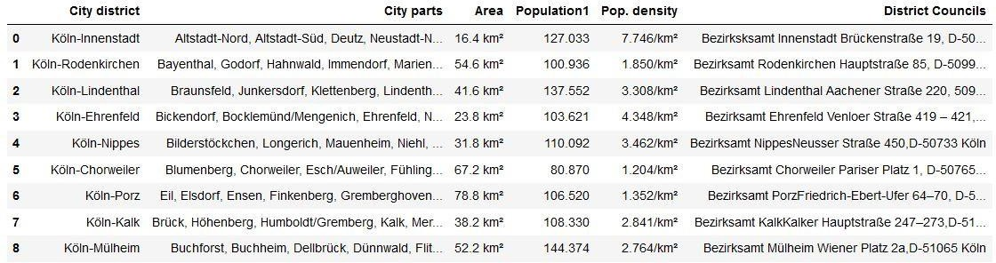
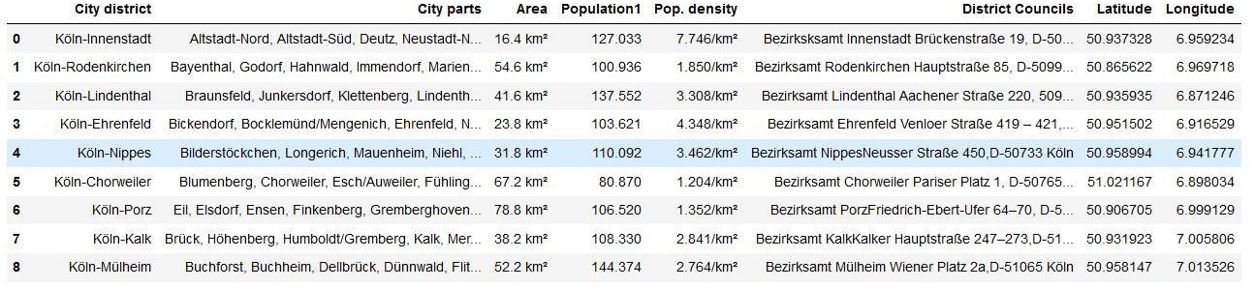
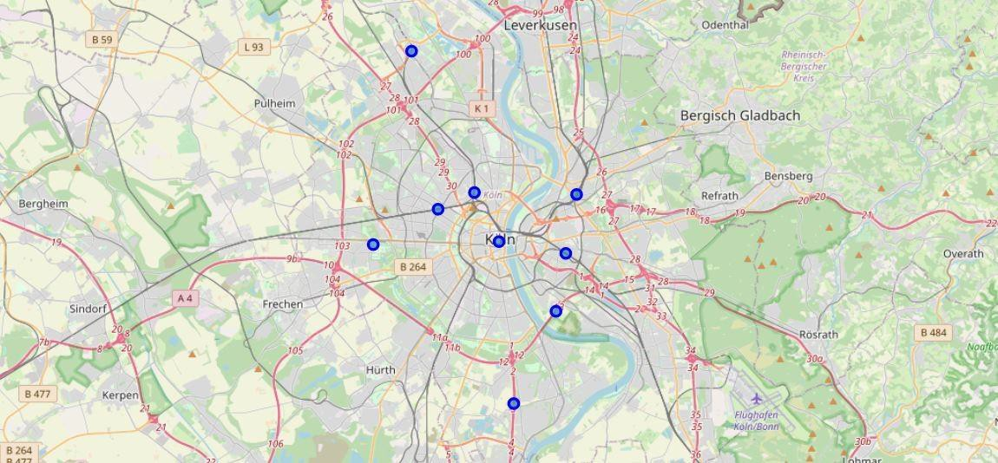
terms of unnecessary information or data that could not be handled in a data frame, such as picture data of the coat of arms of each district. The result is a nice data frame:
Then, I enabled geopy functions by installing the conda-forge geopy package. I used the nominatim function to add geospatial data to the data frame, that is the latitude and the longitude seen on the right side of the following table.
Visualization of city parts

Slide 4
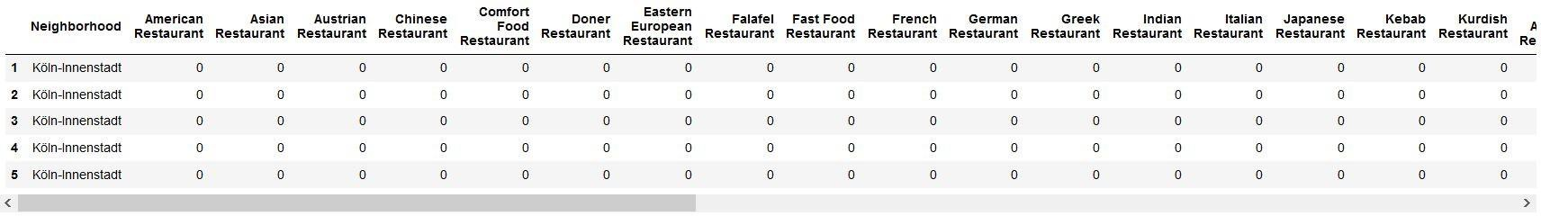
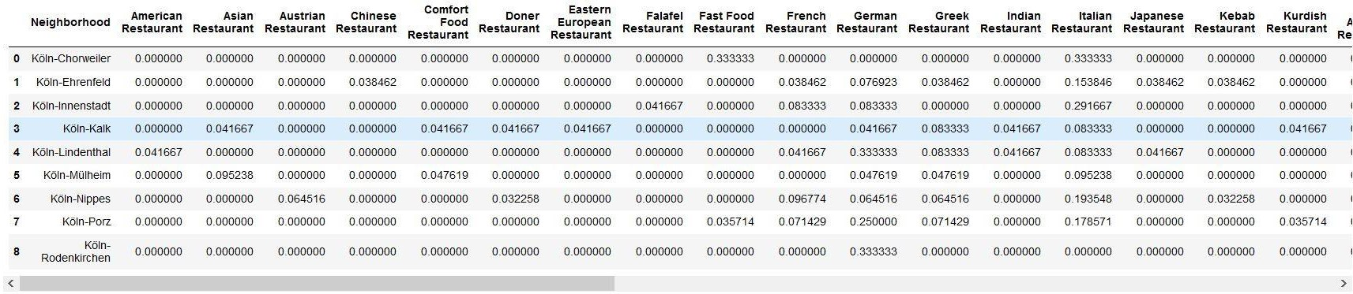
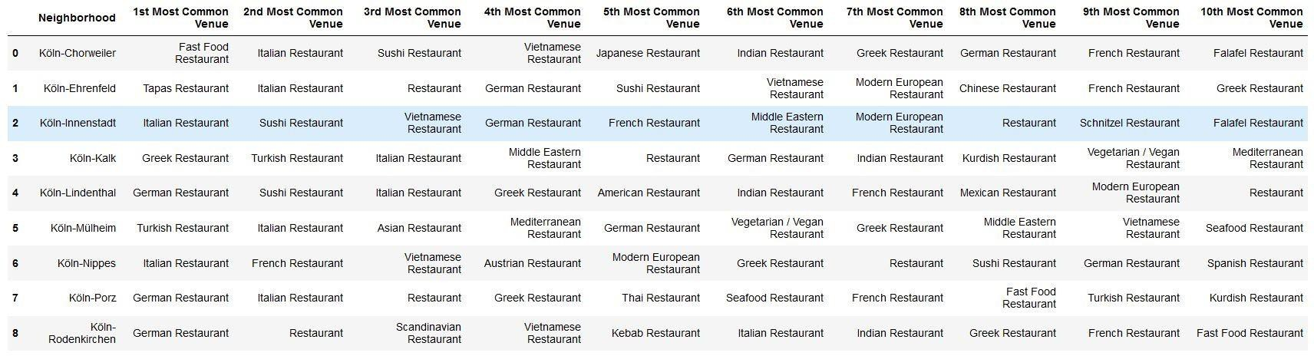
Now, foursquare data comes into play. I first did a view try-outs for the city district "Innenstadt", which I know pretty well, to see if the venues retrieved from foursquare seem reasonable and correct. That was the case.
To find clusters of restaurant types in the different city districts, I first transformed the data frame with the restaurant venues, associated to city districts, by one-hot encoding (0/1), as seen in the picture below.
Next, I used grouping to show the frequency of each category of restaurants in each city district.
I used this information to create a data frame in which you can see the most common restaurant venue types for each city district.
Now, with all this data, I could finally run an unsupervised machine learning algorithm, more specifically, a k-means clustering algorithm from the scikit-learn package. One could use the ellbow method to systematically define the k value, but I simply chose k to be 5, having been inspired by one of the coursera courses to do so.
Results and Conclusion

Slide 5
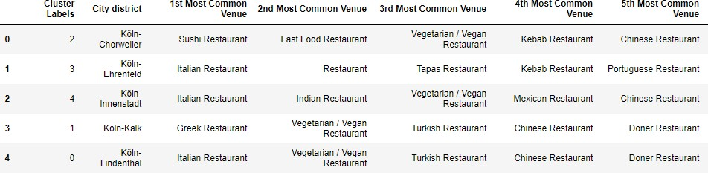
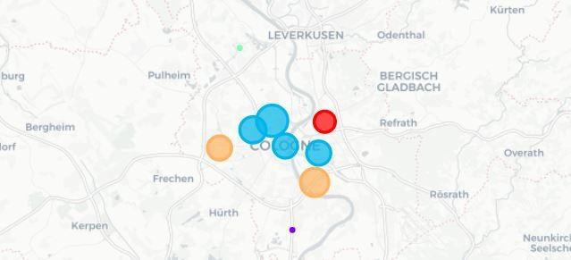
What we see in the table are the city districts and their most common venues, and they now have been assigned five different cluster labels from 0 to 4.
We can now use the cluster labels to show the city districts marked with a cluster-specific color on a map, again using folium:
Clusters view
You will see nine bubbles for the nine city districts, with five different colors for the five different clusters. If you have trouble counting to five here, look for a small green dot on the upper part of the picture and a small purple dot on the lower part of the picture.
Now, what is the final result of this exercise? We now can show five clusters of restaurant type concentrations for the city of Cologne, which I named according to the restaurant concentration the data shows.
Living in Cologne will probably agree that these clusters sound pretty reasonable and are not too far away from what you would have expected.

